Slide 1
Simplex Control and Message/ACK Exchange - Module 6 Final Presentation
Le Wang: lewang@wpi.edu
Renato Iida: rfiida@wpi.edu
Rebecca Cooper: rrcooper@wpi.edu

Slide 2
Outline
Purpose
Data Transmission in the MAC Layer
Building the MAC Frame
State Machine for the Frame Transmission
ACK Timeout
Other Features Considered
Implementation
Interfacing with the other Modules
‘End-to-End’ Simulation of Data Transmission and ACK Response
Lessons Learned

Slide 3
Outline
Purpose
Data Transmission in the MAC Layer
Building the MAC Frame
State Machine for the Frame Transmission
ACK Timeout
Other Features Considered
Implementation
Interfacing with the other Modules
‘End-to-End’ Simulation of Data Transmission and ACK Response
Lessons Learned

Slide 4
Purpose
Establishing end-to-end network resource allocation management in simplex mode.
Exchanging of control information and message/ACK forwarding between the UEs and the BS units.

Slide 5
Outline
Purpose
Data Transmission in the MAC Layer
Building the MAC Frame
State Machine for the Frame Transmission
ACK Timeout
Other Features Considered
Implementation
Interfacing with the other Modules
‘End-to-End’ Simulation of Data Transmission and ACK Response
Lessons Learned

Slide 6
Building the MAC Frame
The package format must be small enough that it is easy to handle
It must also convey useful information
Receiver UE
Sender UE
Data
Receiver UE
1 byte
Sender UE
1 byte
Data

Slide 7
Building the MAC Frame
The Routing between Base Stations:
Transmit the entire routing path
This is very long
It requires additional processing at the Base Station
Sender Base Station
1 byte
Receiver Base Station
1 byte
Option 1
Routing Path
1 bytes
Option 1
Receiver UE
1 byte
Sender UE
1 byte
Data

Slide 8
Building the MAC Frame
The Routing between Base Stations:
Transmit the next stage in the path
The Base Station must change the value of this field every time
Next Stage
1 bytes
Option 2
Receiver UE
1 byte
Sender UE
1 byte
Data

Slide 9

Building the MAC Frame
The Routing between Base Stations:
Read the receiver at the Base Station and determine the routing to destination
Easy to understand
The header stays small
Option 3
Base Station
Receiver UE
1 byte
Sender UE
1 byte
Data

Slide 10
Building the MAC Frame
Frame Type:
Differentiates between the uses of the MAC frames
The INVALID frame type is used to drop corrupt frames
Also helps with error detection through hamming distance
DATA 1111 0000 = 240
ACK 1111 1111 = 255
INVALID 0000 0000 = 0
Frame Type
1 byte
Receiver UE
1 byte
Sender UE
1 byte
Data
(optional)

Slide 11
Building the MAC Frame
Data Size:
Set a maximum size for all MAC frames of 240 bytes or 1920 bits
Transmitting the data size allows us to cut off padding added by the physical layers
Max: 240 bytes
Frame Type
1 byte
Receiver UE
1 byte
Sender UE
1 byte
Data Size
1 byte
Data
(optional)
236 bytes

Slide 12
Building the MAC Frame
CRC:
We must be sure that the Data is transmitted without errors
CRC-8 to check the integrity of the bits
simple and fast but does not correct errors.
Team 4 needs to be sure that the header is correct
Max:240 bytes
Frame Type
1 byte
Receiver UE
1 byte
Sender UE
1 byte
Data Size
1 byte
Check
Header 1 byte
Data
(optional)
1-234 bytes
Check Data
(optional)
1 byte
Header: 5 bytes

Slide 13
Building the MAC Frame
ACK Frame:
5 bytes
Frame Type
1 byte
Receiver UE
1 byte
Sender UE
1 byte
Data Size
1 byte
Header Check
1 byte
Data Frame:
Max: 240 bytes
Frame Type
1 byte
Receiver UE
1 byte
Sender UE
1 byte
Data Size
1 byte
Header Check
1 byte
Data
1-234 bytes
Data Check
1 byte
Header: 5 bytes

Slide 14
Outline
Purpose
Data Transmission in the MAC Layer
Building the MAC Frame
State Machine for the Frame Transmission
ACK Timeout
Other Features Considered
Implementation
Interfacing with the other Modules
‘End-to-End’ Simulation of Data Transmission and ACK Response
Lessons Learned

Slide 15
State Machine for Frame Transmission
Set Flag for Data Transmission
ACK
Timeout counter
Stop
Stop Timeout Counter
Check Address Book for Receiver
Timeout: Triggers re-send
Start Counter
Drop frame
(Timeout will trigger)
Create data frame
(Frame = header + data)
UE Sends & BS Receives
Create ACK frame
Frame = header
Receiver = old Sender
Data Corrupt
INVALID
CRC match
Check data CRC
Check header
Read header
(Check Receiver ID in switching table)
DATA
BS Sends & BS Receives
Send to BS or UE?
BS Sends & UE Receives
Unpack frame
(Check the CRC of the header)
BS
UE

Slide 16
Outline
Purpose
Data Transmission in the MAC Layer
Building the MAC Frame
State Machine for the Frame Transmission
ACK Timeout
Other Features Considered
Implementation
Interfacing with the other Modules
‘End-to-End’ Simulation of Data Transmission and ACK Response
Lessons Learned

Slide 17
ACK Time Out
Shortest message
UE2 to UE1
6 Time Slots
Data
ACK
To BS1
To UE1
To BS1
To UE2
UE1
UE2
BS1
UE1
UE2
BS1
UE3
BS2
UE3
BS2
Longest message
UE3 to UE1
12Time Slots
Data
ACK
To UE1
To BS1
To BS2
UE1
UE2
BS1
UE1
UE2
BS1
UE1
UE2
BS1
UE3
BS2
UE3
BS2
UE3
BS2
To BS2
To BS1
To UE3

Slide 18
Outline
Purpose
Data Transmission in the MAC Layer
Building the MAC Frame
State Machine for the Frame Transmission
ACK Timeout
Other Features Considered
Implementation
Interfacing with the other Modules
‘End-to-End’ Simulation of Data Transmission and ACK Response
Lessons Learned

Slide 19
Other Features Considered
Sequence number
Sliding window
Group ACK
NACK

Slide 20
Outline
Purpose
Data Transmission in the MAC Layer
Building the MAC Frame
State Machine for the Frame Transmission
ACK Timeout
Other Features Considered
Implementation
Interfacing with the other Modules
‘End-to-End’ Simulation of Data Transmission and ACK Response
Lessons Learned

Slide 21
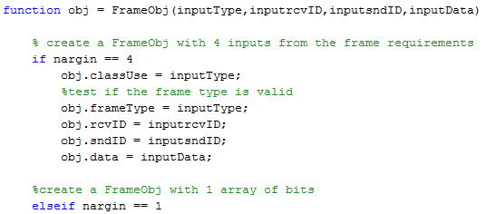
Implementation Constructor
Constructor method
Verification of the number of inputs

Slide 22
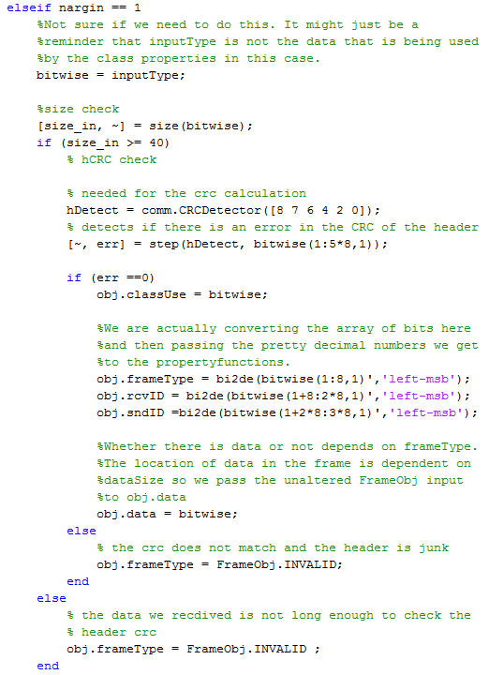
Implementation Constructor
Check for the minimum size
CRC check the header.
Failed checks result in INVALID frame types
CRC check the header.

Slide 23
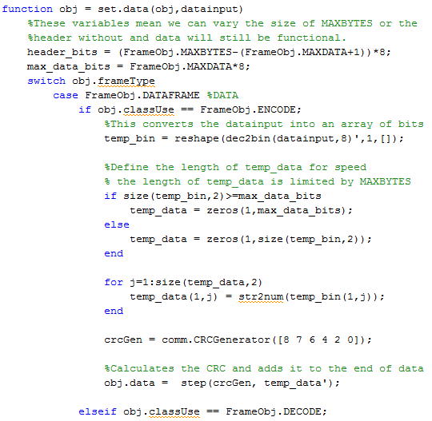
Implementation Data field
Maximum size of data field
Maximum size of data field
Mapping chars to bits
Creation of CRC

Slide 24
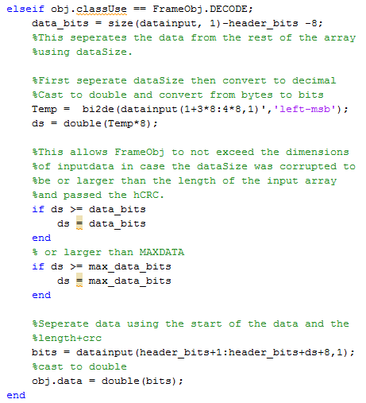
Implementation Data field
Extract the data size
The dimensions of the input limit the data size
Maximum size of data field

Slide 25
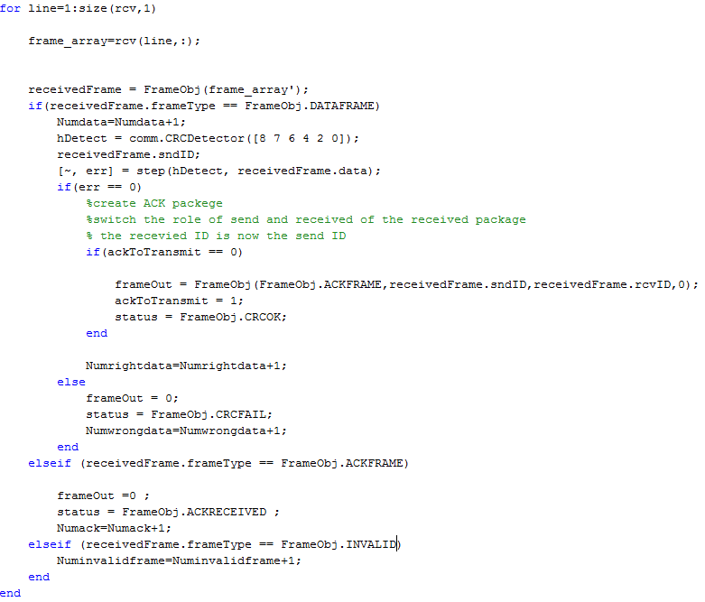
Implementation Receiving a Frame
Check the FrameType
Verify the data CRC
Create only one ACK to send back
Drop INVALID Frame

Slide 26
Outline
Purpose
Data Transmission in the MAC Layer
Building the MAC Frame
State Machine for the Frame Transmission
ACK Timeout
Other Features Considered
Implementation
Interfacing with the other Modules
‘End-to-End’ Simulation of Data Transmission and ACK Response
Lessons Learned

Slide 27
Interfacing Diagram

Slide 28
Interfacing with the Physical Modules
Teams 1, 2 & 3
Format of the bits that are generated by FrameObj
Length of the frame
Order of the bits
How to exchange data between the layers
Flags to indicate new messages
Callbacks
Team 3
Additional processing to route the message

Slide 29
Interfacing with the Network Modules
Team 4
The ACK frame is reused
The same basic frame construction is used
Polling Frame
Request Frame
Team 5
The address table determines which physical resource will route the frames.
The same basic frame construction is used
Table Frame

Slide 30
FrameType Functionality
Data Transmission with Transceiver from Lab 2
Frame Type | Number Received
ACKFRAME | 2
DATAFRAME Correct CRC Corrupt CRC | 102 100 2
INVALID | 3466
False Detection of ACK frame because similar frameType numeric representation.
We increased the hamming distance between the values of the types of frames to avoid false detection
Frame Type | Number Received
ACKFRAME | 0
DATAFRAME Correct CRC Corrupt CRC | 165 161 4
INVALID | 3559

Slide 31
Outline
Purpose
Data Transmission in the MAC Layer
Building the MAC Frame
State Machine for the Frame Transmission
ACK Timeout
Other Features Considered
Implementation
Interfacing with the other Modules
‘End-to-End’ Simulation of Data Transmission and ACK Response
Lessons Learned

Slide 32
‘End-to-End’ Simulation of Data Transmission and ACK Response Using Team 4’s Transceiver

Slide 33
Outline
Purpose
Data Transmission in the MAC Layer
Building the MAC Frame
State Machine for the Frame Transmission
ACK Timeout
Other Features Considered
Implementation
Interfacing with the other Modules
‘End-to-End’ Simulation of Data Transmission and ACK Response
Lessons Learned

Slide 34
Lessons Learned
The Physical layer is very important, we cannot compensate for unreliable data transmission.
We can accommodate erroneous data through verifying the data range and considering possible received values
Hamming distance of the frame type are very important
More data types are needed for the control messages in the system than for transmitting data.

